Slide 1
CSM51A Discussion #4
Hyunjin Kim

Slide 2
Outline
Chapter 5:
K-map
Prime Implicant (implicates)
Essential Prime Implicant (implicates)
NAND-NAND (NOR-NOR) network
5.2, 5.6, 5.8, 5.14,
Programmable Logic Array
5.18

Slide 3
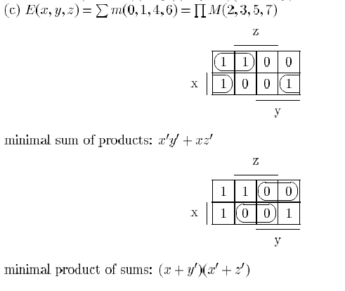

Slide 4
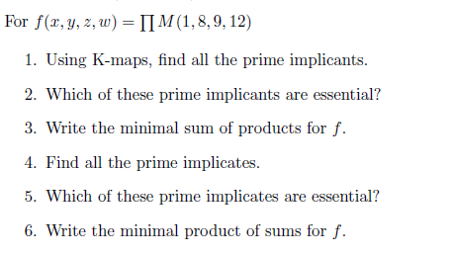

Slide 5
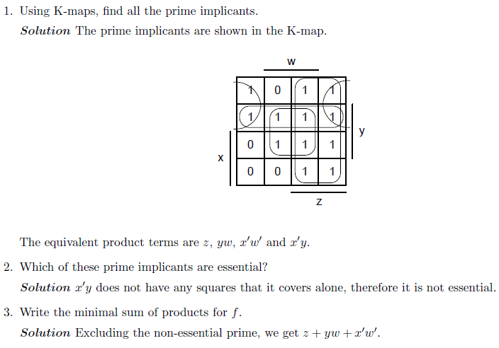
Solution 1/2

Slide 6
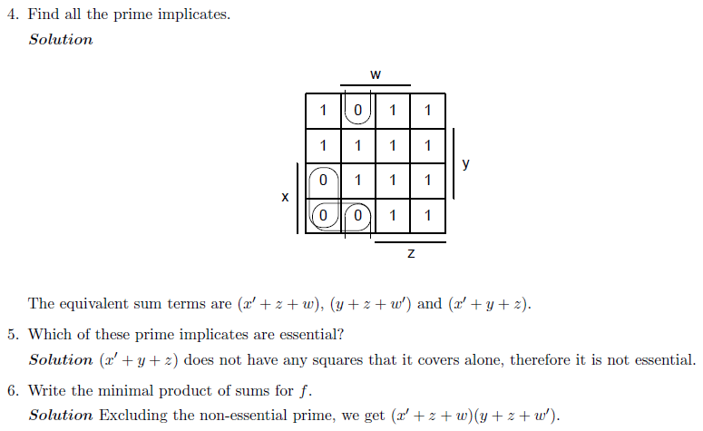
Solution 2/2

Slide 7
5.2 Represent on K-maps the functions described by the following expressions
E(x, y, z) = ∑m(1, 5, 7)
E(w, x, y, z) = w’x’y + y’z + xz’

Slide 8
5.6 Using K-maps, find the minimal sum of products and product of sums that are equivalent to the following expressions:
E(w, x, y, z) = ∏M(1, 3, 4, 7, 10, 13, 14, 15)
E(w, x, y, z) = ∑m(0, 4, 5, 9, 11, 14, 15),
dc(w, x, y, z) = ∑m(2, 8)

Slide 9
5.8 A combinational system has four inputs a, b, c, d, and one output y. The output y is 1 if and only if the number represented by (a, b, c, d) in binary code is prime. Design a minimal two-level network to implement this system (0 and 1 are not prime number):

Slide 10
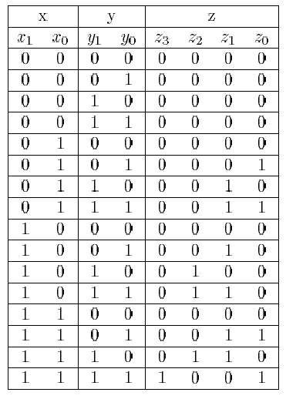
5.14 Design a minimal two-level NAND network that computes the product of two integers, with input values from 0 to 3. Minimize each output expression separately.

Slide 11
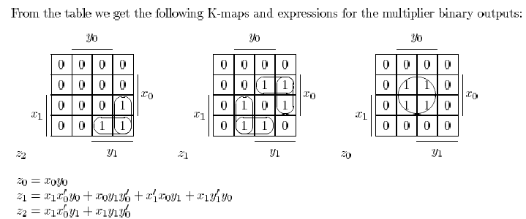
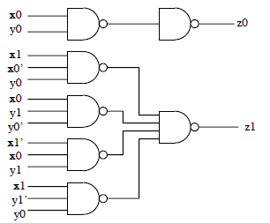
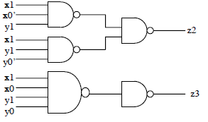

Slide 12
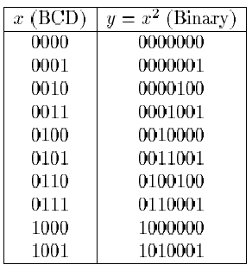

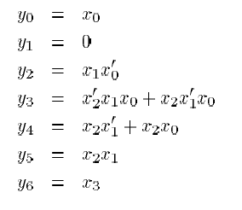
5.18 Using a PLA, implement a system that produces the square of a BCD digit. The output should be in the binary representation.

Slide 13
